Slide 1
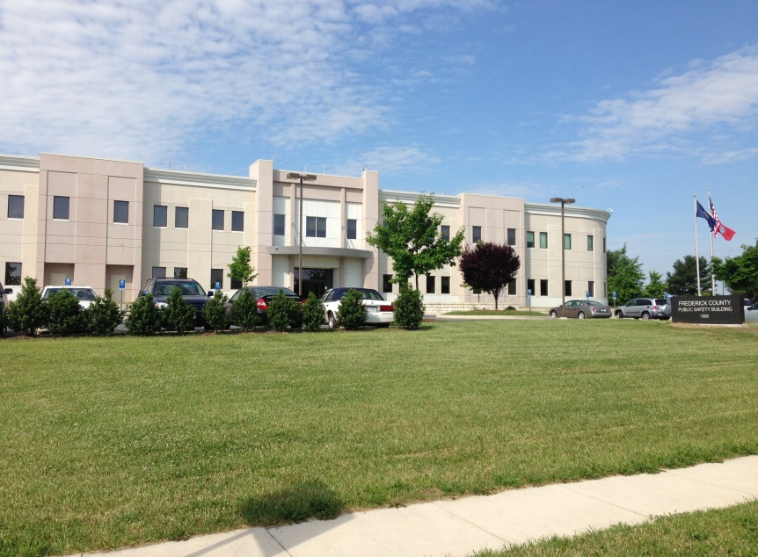
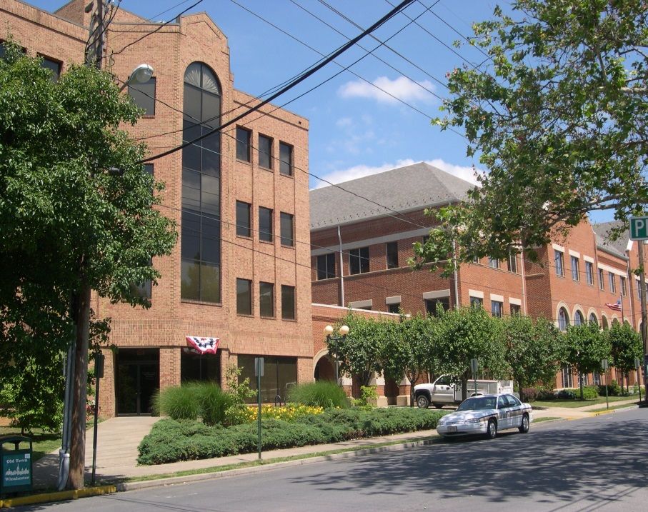
FY 2019 Budget Public Hearing Frederick County, VA
Kris C. Tierney
County Administrator
March 28, 2018

Slide 2
Board Budget Priorities and Objectives
Public Safety and Education needs are highest priorities
Maintain Contingency Fund for unanticipated needs
Address critical staffing shortages
Preserve the fund balance at an appropriate level, in keeping with Board policy and best practices

Slide 3
Budget Priorities and Objectives
Provide sufficient employee compensation to retain quality staff
Provide reasonable funding for schools and public safety

Slide 4
Administrative Objectives
Reduce operating costs and promote efficiencies where possible
Carefully consider funding requests for new initiatives
Address public safety needs
Provide support of technology to ensure equipment & infrastructure are up-to-date
Ensure that critical county and school capital needs are met

Slide 5
Proposed General Fund Revenue Increases
FY 19 Proposed Revenue $ 179,503,228
FY 18 Budgeted Revenue 171,690,869
$ 7,812,359
Natural Increase $ 6,093,123
Proposed tax increase 1,000,000 (1 cent RE tax inc.)
Proposed airplane tax increase 50,000
Categorical 669,236
$ 7,812,359 (4.55% increase)
Does not include funding from Fund Balance
Notes:
.

Slide 6
General Fund Increase in Requests
33 Full-Time positions $2,070,523
Capital Requests 9,188,300
Other Operating 4,223,783
Total Requests $15,482,806

Slide 7
School Request Comparison
School Operating $6,600,000
Proposed budget funds 5,966,044
School Debt Service 14,535,820
Proposed budget funds 14,535,820
School Capital Project Fund 2,700,000
Proposed budget funds 0

Slide 8
General Fund positions requested
Commissioner of the Revenue 2
Commonwealth Attorney 2
Sheriff 8
Fire and Rescue 20
Refuse Collection 1
Animal Shelter 1
Social Services 1
Discussions continue regarding positions to be funded.

Slide 9
School positions requested
30 Instructional (includes teachers, classroom aides, and special education coordinator)
9 Support (Includes bus drivers, facility service technicians, custodian, software trainer and accountant)
Part-time driver reimbursed by City of Winchester
1 Mechanic

Slide 10
FY 2019 Advertised Budget – All Funds $319,822,441 Where Does It Go?

Slide 11
General Fund Revenues – FY 2018 to FY 2019
Category | FY 2018 | FY 2019 | Difference
General Property Taxes | $117,080,093 | 123,179,515 | 6,099,422
Other Local Taxes | $35,717,875 | 36,959,731 | 1,241,856
Permits/Privilege Fees | $2,004,806 | 1,838,386 | -166,420
Fines/Forfeitures | $415,400 | 323,270 | -92,130
Use of Money/Property | $192,068 | 526,810 | 334,742
Charges for Services | $3,076,558 | 3,061,899 | -14,659
Misc. Revenues | $163,317 | 180,090 | 16,773
Recovered Costs | $1,559,454 | 1,618,949 | 59,495
State | $10,447,498 | 11,814,578 | 1,367,080
Federal | $1.033,800 | 0 | -1,033,800
Fund Balance | $7,918,047 | 1,100,000 | -6,818,047
Total | $179,608,916 | $180,603,228 | $994,312

Slide 12
FY 2019 Proposed General Fund Revenue $180,603,228
Category
General Prop. Taxes | 123,179,515
Other Local Taxes | 36,959,731
Permits/Fees | 1,838,389
State Revenue | 11,814,578
Charges for Services | 3,061,899
Recovered Costs | 1,618,949
Other – Misc. | 1,030,167
Fund Balance | 1,100,000
 | 180,603,228

Slide 13
FY 2019 Proposed General Fund Budget Expenditures $180,603,228 Where Does It Go?

Slide 14
Unfunded School Capital Requests
Replacement cooling tower at JWMS
Partial roof replacement at Dowell J Howard
Replacement heat pumps at JWHS and Apple Pie Ridge
Fire alarm replacement at Bass-Hoover
Tennis court renovation at Sherando
Extend the northbound left turn lane along 522 at FCMS to improve visibility over blind hill

Slide 15
Unfunded County Capital Requests
Updated portable and mobile radios for Sheriff’s Office
Clearbrook Park parking lot
Sherando Park northwest bathroom
Alterations to North Building lobby for storage of voting machines
Hydraulic Extraction Equipment
Sheriff Response armored vehicle for Tactical team
Sherando softball complex
Snowden Bridge Park development
6 Continental washer/extractors for Fire and Rescue

Slide 16
General Fund Budgets - History
Proposed
Notes:
.

Slide 17
School Operating Fund Revenues FY 2018 to FY 2019
Category | FY 2018 | FY 2019 | Change
Revenue from Local Sources | $967,716 | $944,326 | -$23,390
State | $75,982,926 | $79,566,124 | $3,583,198
Federal | $5,037,745 | $5,570,556 | $532,811
Transfer from School Debt | $617,478 | 0 | -$617,478
General Fund Transfer | $77,273,630 | $83,239,674 | $5,966,044
Total | $159,879,495 | $169,320,680 | $9,441,185

Slide 18
School Operating Fund Revenues $169,320,680

Slide 19
Frederick County Public Schools Budget Facts
Student population for FCPS is expected to increase for FY 2019 by 302 students to a total population of 13,705.
For FY 2019, the FCPS cost per student is projected to be $12,790. In comparison, cost per student for FY 2016 was $11,409 and FY 2015 was $11,009.
The proposed increase in the local transfer to the School Operating Fund is $5,966,044.

Slide 20
Adopted School Operating Fund Budgets - History
Proposed

Slide 21
Transfer to School Operating Fund - History
Proposed

Slide 22
Current Real Estate Tax Rates of Surrounding and Similar Localities Frederick County Budgeted revenue 59 million

Slide 23
Current Personal Property Tax Rates of Surrounding and Similar Localities Frederick County Budgeted revenue 52 Million

Slide 24
Median Income of Surrounding and Similar Localities

Slide 25
Per Capita Expenditure Comparison of Surrounding and Similar Localities
Source: APA 2016 Comparative Cost Report. 2017 data not yet available.

